Slide 1







Pseudo E-Challan System
Automated Traffic Violation Detection & Management
Semester Project | BS Software Engineering

Slide 2




PROBLEM STATEMENT
Manual Inefficiency
Data Lag
Current manual traffic management systems suffer from slow response times and high human error rates in challan generation.
Delay between violation detection and fine issuance reduces the effectiveness of traffic law enforcement and public safety.
Absence of image-based proof for traffic violations.
Difficulty in maintaining consistent databases without complex SQL overhead.
Need for a lightweight, automated, and cost-effective digital solution.
Pseudo E-Challan System
Slide 02

Slide 3






CORE PROJECT OBJECTIVES
Detection
Storage
Notification
Implement Computer Vision to detect traffic violations and extract vehicle number plates in real-time.
Utilize .json pseudo-databases for efficient, lightweight data management of users and fines.
Automate the delivery of proof-based challans via email notifications to vehicle owners.
Pseudo E-Challan System
Slide 03

Slide 4
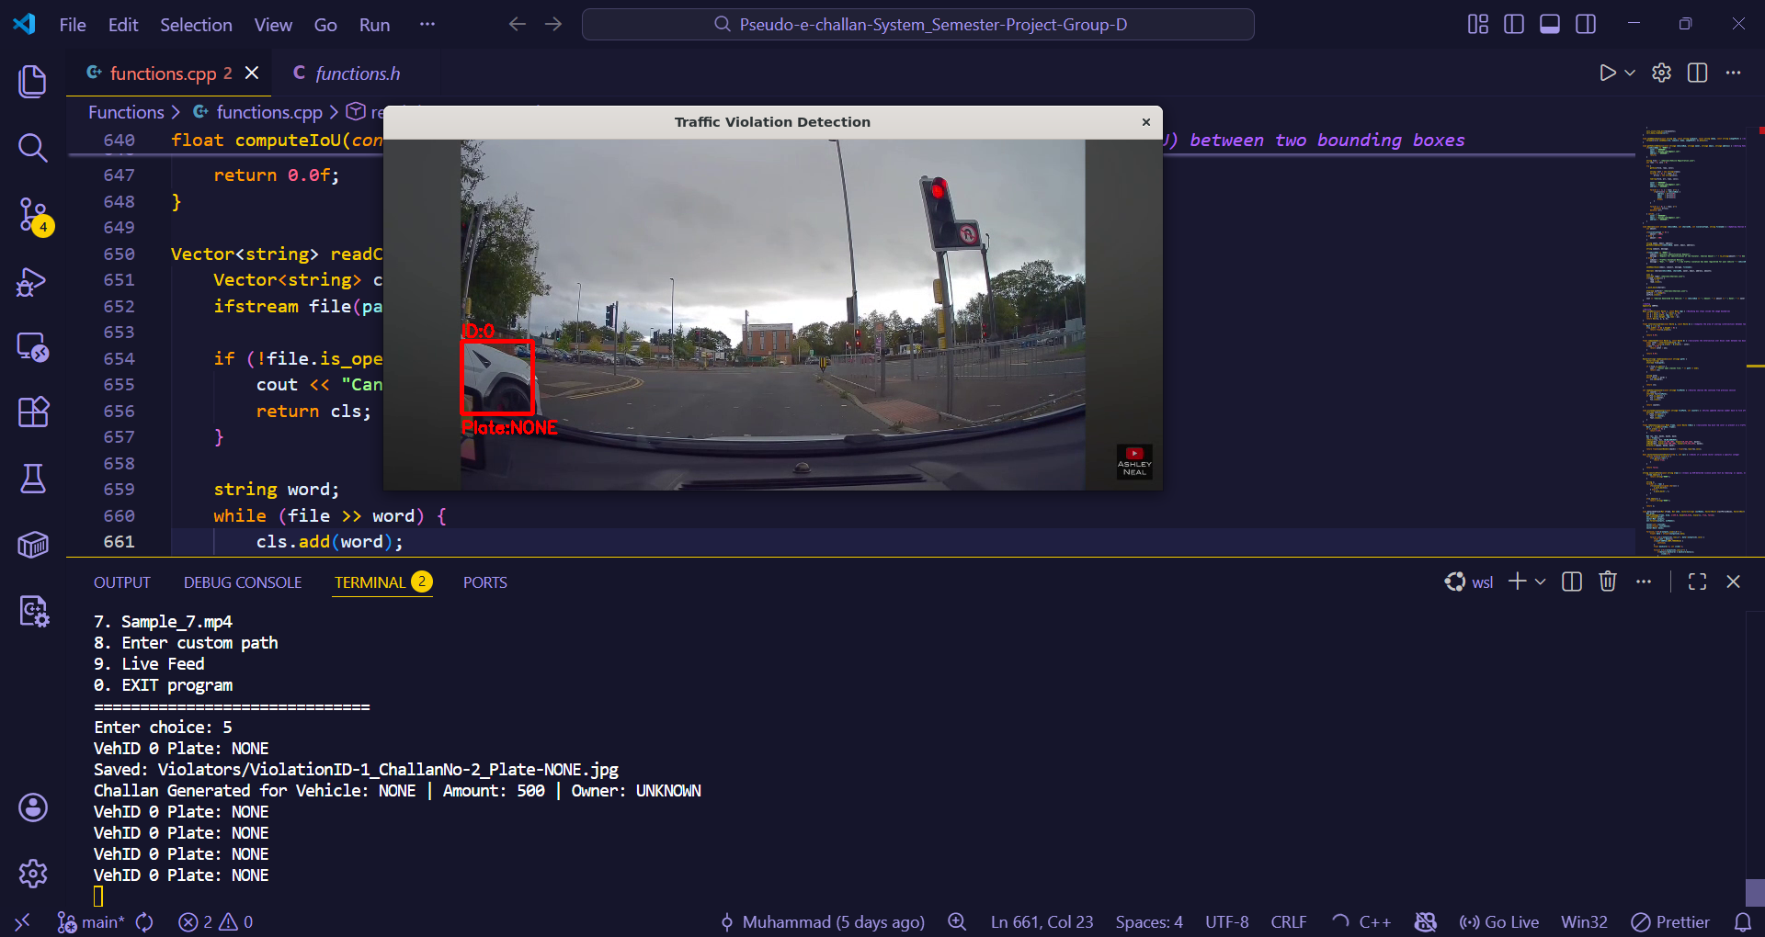
SYSTEM ARCHITECTURE FLOW
Input Module: High-resolution camera stream or image input.
Processing Engine: C++ & OpenCV for image filtering and plate recognition.
Data Layer: Pseudo DB handling registrations and violations.
Output Layer: CLI visualization and SMTP Email Module.
Architecture Overview
Slide 04

Slide 5





TECHNOLOGIES & FRAMEWORKS
C++
OpenCV
JSON
Core programming language used for high-performance processing and system logic.
Industry-standard library for computer vision tasks and image extraction.
Lightweight data interchange format used as a pseudo database structure.
Additional tools: SMTP Protocol for Emails | YOLO for Object Detection | harcascade classifier for Plate Recognition
Technology Stack
Slide 05

Slide 6
JSON PSEUDO DATABASE DESIGN
Filename | Primary Fields | Function
Registrations.json | Plate_No, Owner_Name, Email | Stores authorized vehicle/owner links
Challans.json | Challan_ID, Plate_No, Fine_Amount | Master record for all issued fines
Accounts.json | Owner_Name, Email, Money | Financial analytics and system health
Admin.json | admin, password | Admin authentication
Database Structure
Slide 06

Slide 7
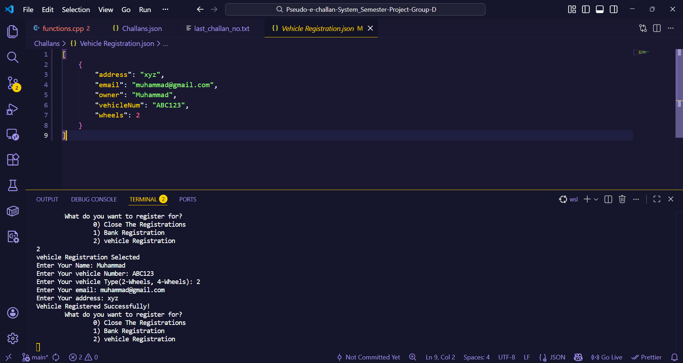

MODULE 1: REGISTRATION SYSTEM
Onboarding Workflow
The Registration Module ensures every vehicle is mapped to an owner before monitoring begins.
User-friendly input for vehicle specifications.
Automated JSON serialization for storage.
Unique ID generation for tracking.
Vehicle Registration
Slide 07

Slide 8
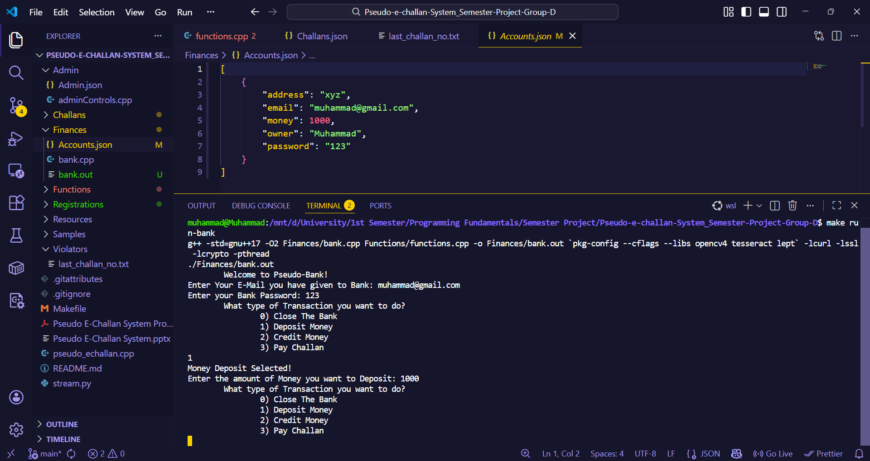



MODULE 2: PAYMENT HANDLING
Financial Integration
Managing the lifecycle of a challan from issuance to clearance.
Status Updates: Real-time update of JSON records upon successful payment simulation.
Fee Structure: Automated calculation based on violation types detected by OpenCV.
Bank Module
Slide 08

Slide 9
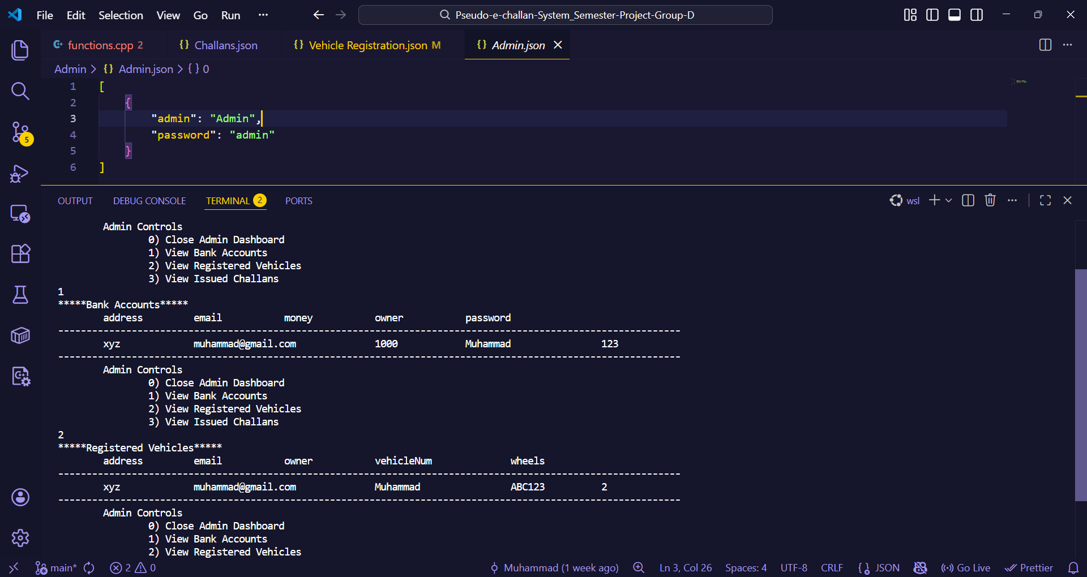
ADMIN DASHBOARD
The central hub for system monitoring. Admins can view comprehensive analytics, manage vehicle records, and track revenue collection.
Live Challan Monitoring
Database Management (CRUD)
Revenue Analytics Visualization
Management Console
Slide 09

Slide 10
MODULE 4: CHALLAN GENERATION
Automated Proof Logic
Leveraging OpenCV to provide irrefutable evidence for every violation.
Extraction: Cropping number plates from image frames.
Proof Attachment: Storing violation images linked to IDs.
Automation: Triggering system events on detection.
OpenCV Detection
Slide 10

Slide 11

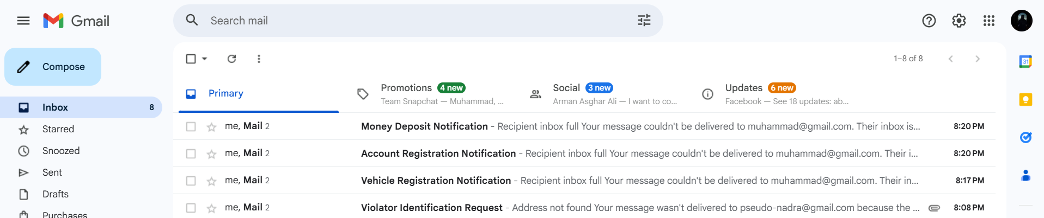
EMAIL NOTIFICATION SYSTEM
100%
Notification Reliability
Automated SMTP triggers ensure owners receive alerts within seconds of violation detection.
Alert Module
Slide 11

Slide 12
KEY CHALLENGES & SOLUTIONS
Detection Accuracy: Initial plate recognition was affected by lighting; solved using OpenCV grayscale filtering and Gaussian blur.
JSON Consistency: Concurrent read/write issues handled by implementing strict file streaming and verification checks.
CLI Integration: Mapping C++ backend logic to have a user friendly Input/Output Interface.
Development Hurdles
Slide 12

Slide 13

PROJECT CONCLUSION
"
The Pseudo E-Challan system represents a significant step toward automated urban traffic management, combining computer vision with lightweight data solutions.
By automating detection and fine issuance, we can significantly reduce manual labor, increase transparency, and improve road safety through immediate evidence-based enforcement.
Summary
Slide 15

Slide 14

Questions?
We would love to hear your feedback and answer any queries.
Team Members: Muhammad | Fatima Saeed | Eman Fatima | Minahil Hammad
GitHub Repository: Pseudo-E-Challan-System
Link: https://github.com/ITU-Lahore-CFP/fall2025-se101-pf-project-pseudo-e-challan-system-group-d.git

